Slide 1
Week 4: Examples of annotated bibliography and literature review
INFT 4017

Slide 2
An example of Annotated Bibliography

Slide 4
Examples of Literature Review

Slide 5
Example of bad review

Slide 6
Example of good review

Slide 7
Common concerns
Does the review need to be comprehensive and exhaustive, covering all the literature? Or to what extent can it be selective?
Literature here means “relevant literature”. Classifying literature as centrally relevant, marginally relevant or only of background and contextual relevance may be useful.

Slide 8
For some topics, the volume of related literature is so great that a single research paper cannot be covering everything. In this case, the researcher is forced to be selective (based on which the selection is made and why it is being done - multi-criteria – reasonably recent work, leading journals, leading authors).
For a thesis writing, finding a recent and good literature survey paper (or thesis close to your topic) can save a lot of time and work.

Slide 9
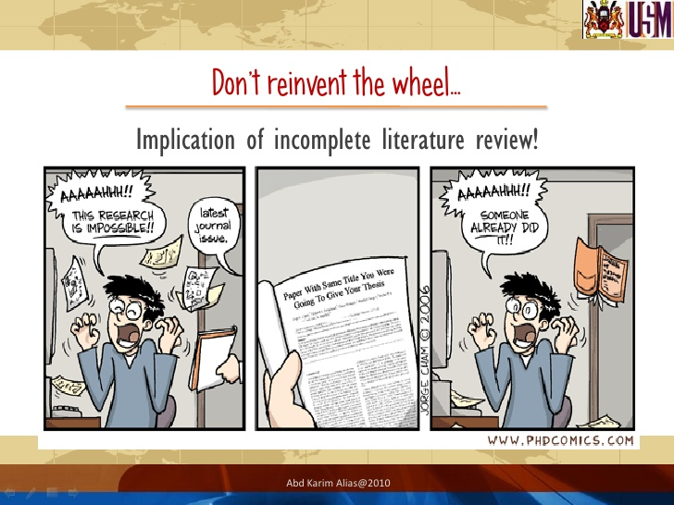
Start your own annotated bibliography and literature review

